Slide 1
Battery Model Insights

Slide 2
Agenda
Project Overview
Project Directory Structure
Key Battery Model Files
Batteries.py - Parameters
Batteries.py - Variables
Batteries.py - Constraints
ExampleBatteryPV_Case_1_131124.py
Optimization Workflow
Data Handling & Solver
Conclusion
Notes:
mscj

Slide 3
Project Introduction
Project Overview: The Battery Model Project aims to enhance synergy between battery storage, photovoltaic systems, and grid performance.
Focus Areas: Key focus includes optimization techniques for maximizing efficiency in energy storage and generation processes.
Integration Importance: A critical aspect is understanding how optimizing both components leads to improved overall energy management.

Slide 4
Project Directory Structure
Directory Structure: The directory contains organized folders for efficient project management and accessibility of files.
Main Folder: 'agistin-Uni-Kassel_Task-3.2' serves as the root, centralizing all project-related documentation and substructures.
Subfolders Overview: Subfolders include 'main' for primary files, 'Cases' for data, and 'Devices' for Python scripts.

Slide 5
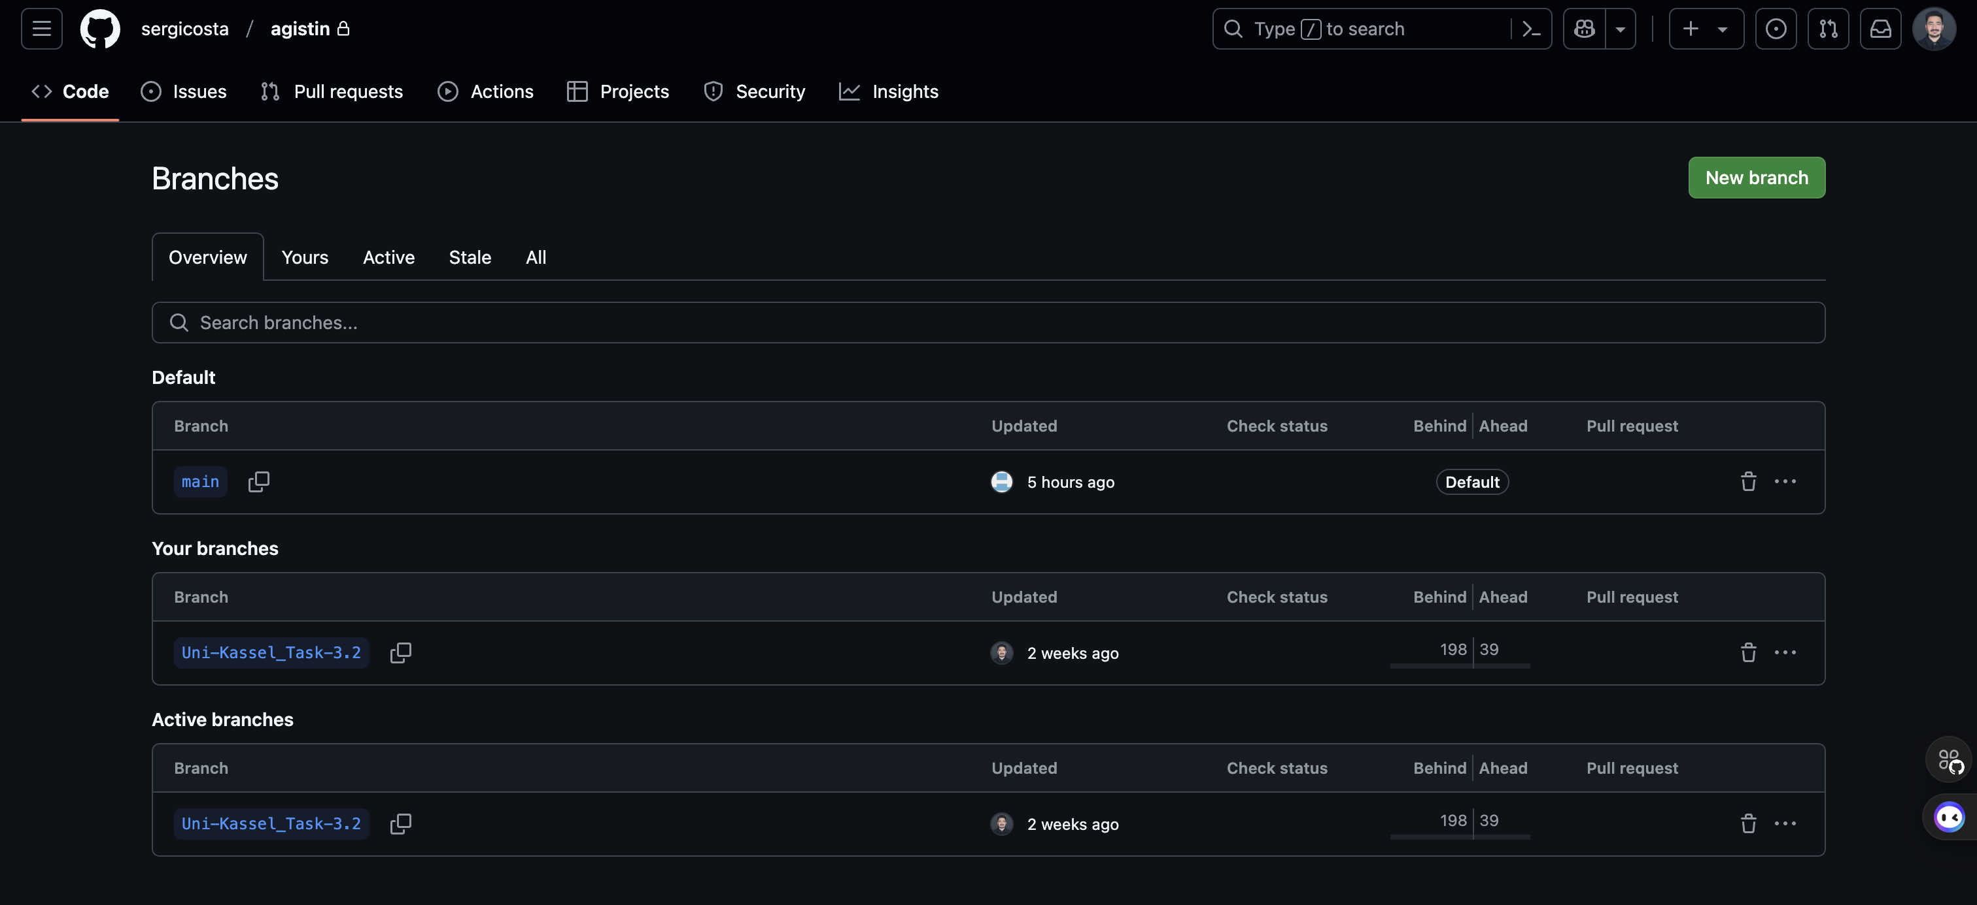
1- This is our GitHub repository.[https://github.com/sergicosta/agistin/branches] 2- It contains a main file where all official work is updated. 3- Additionally, we have a copy of the file where we work, which I have highlighted.

Slide 6
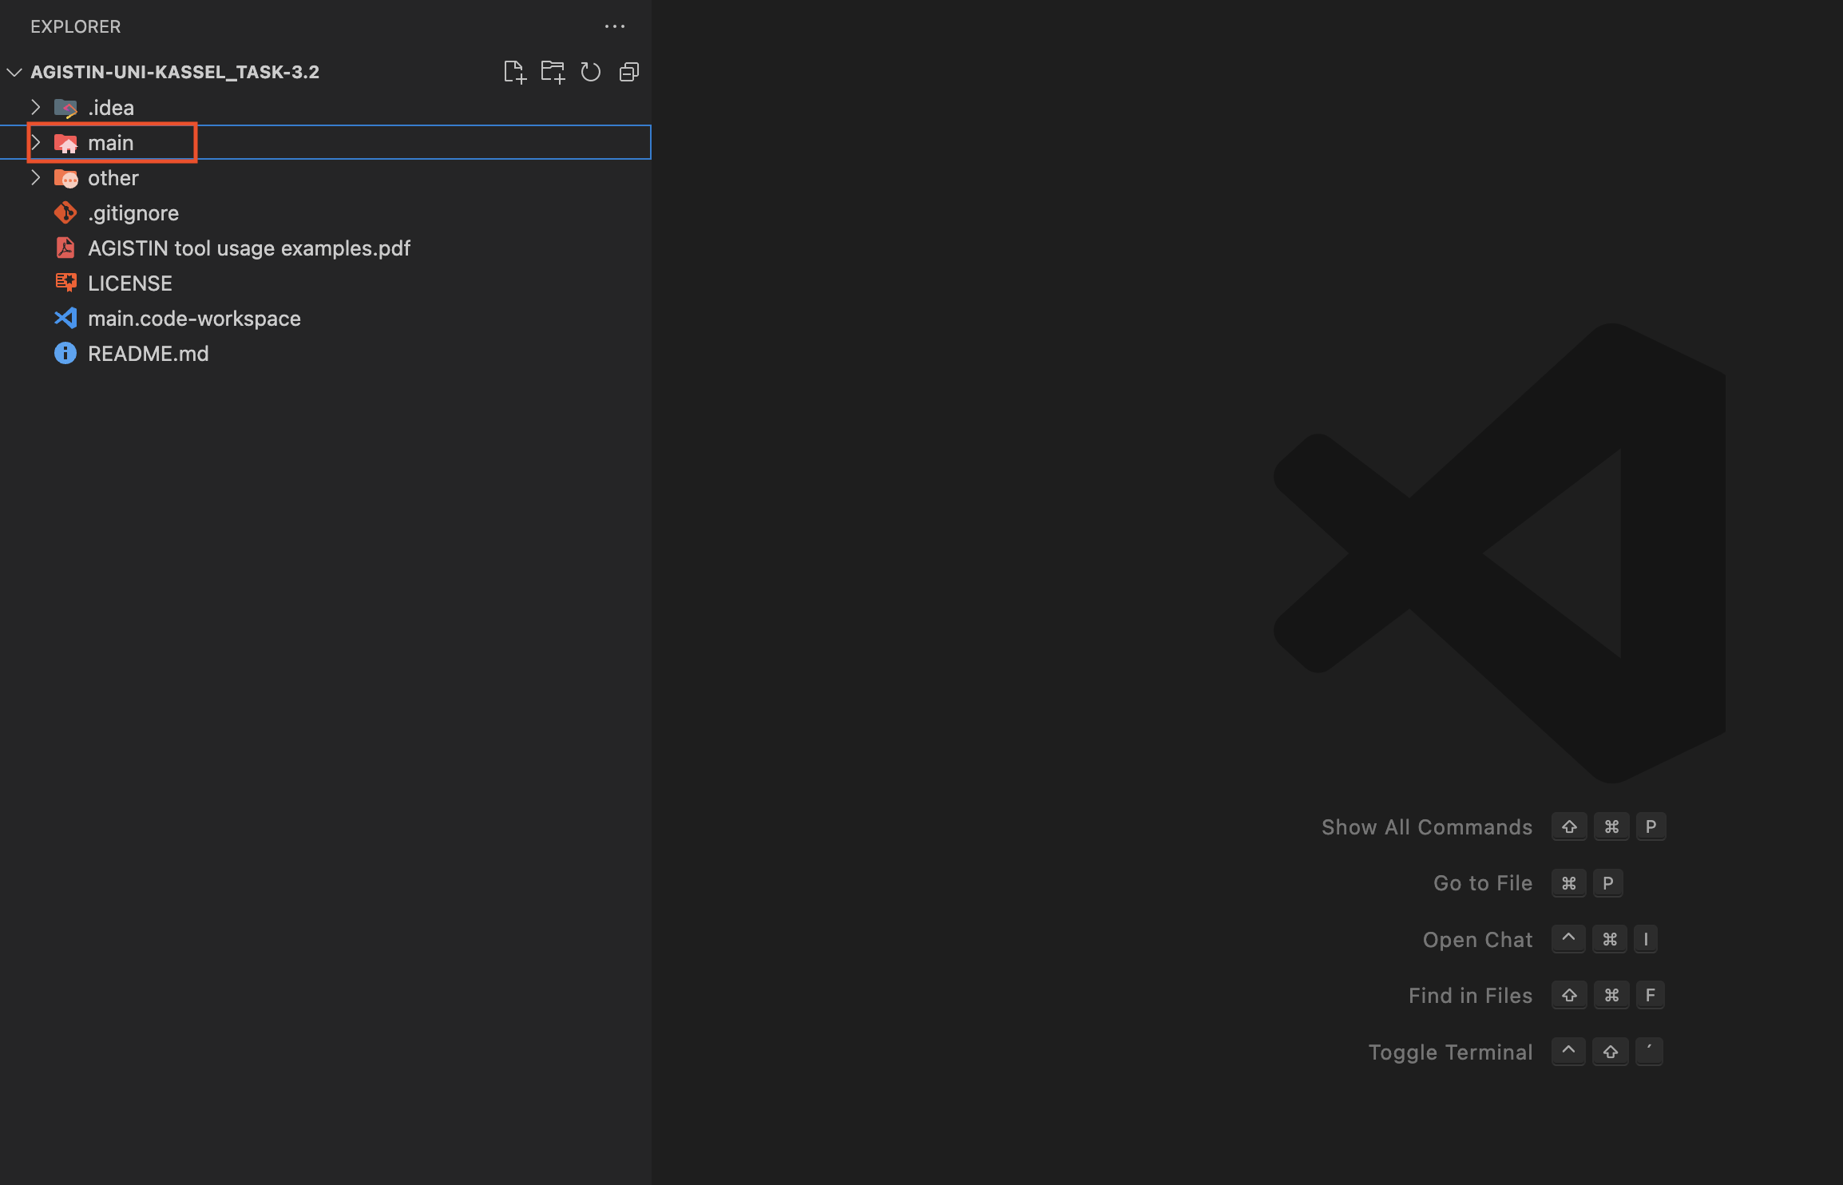
1- In this, we first have a main folder that contains subfolders and files inside it.

Slide 7
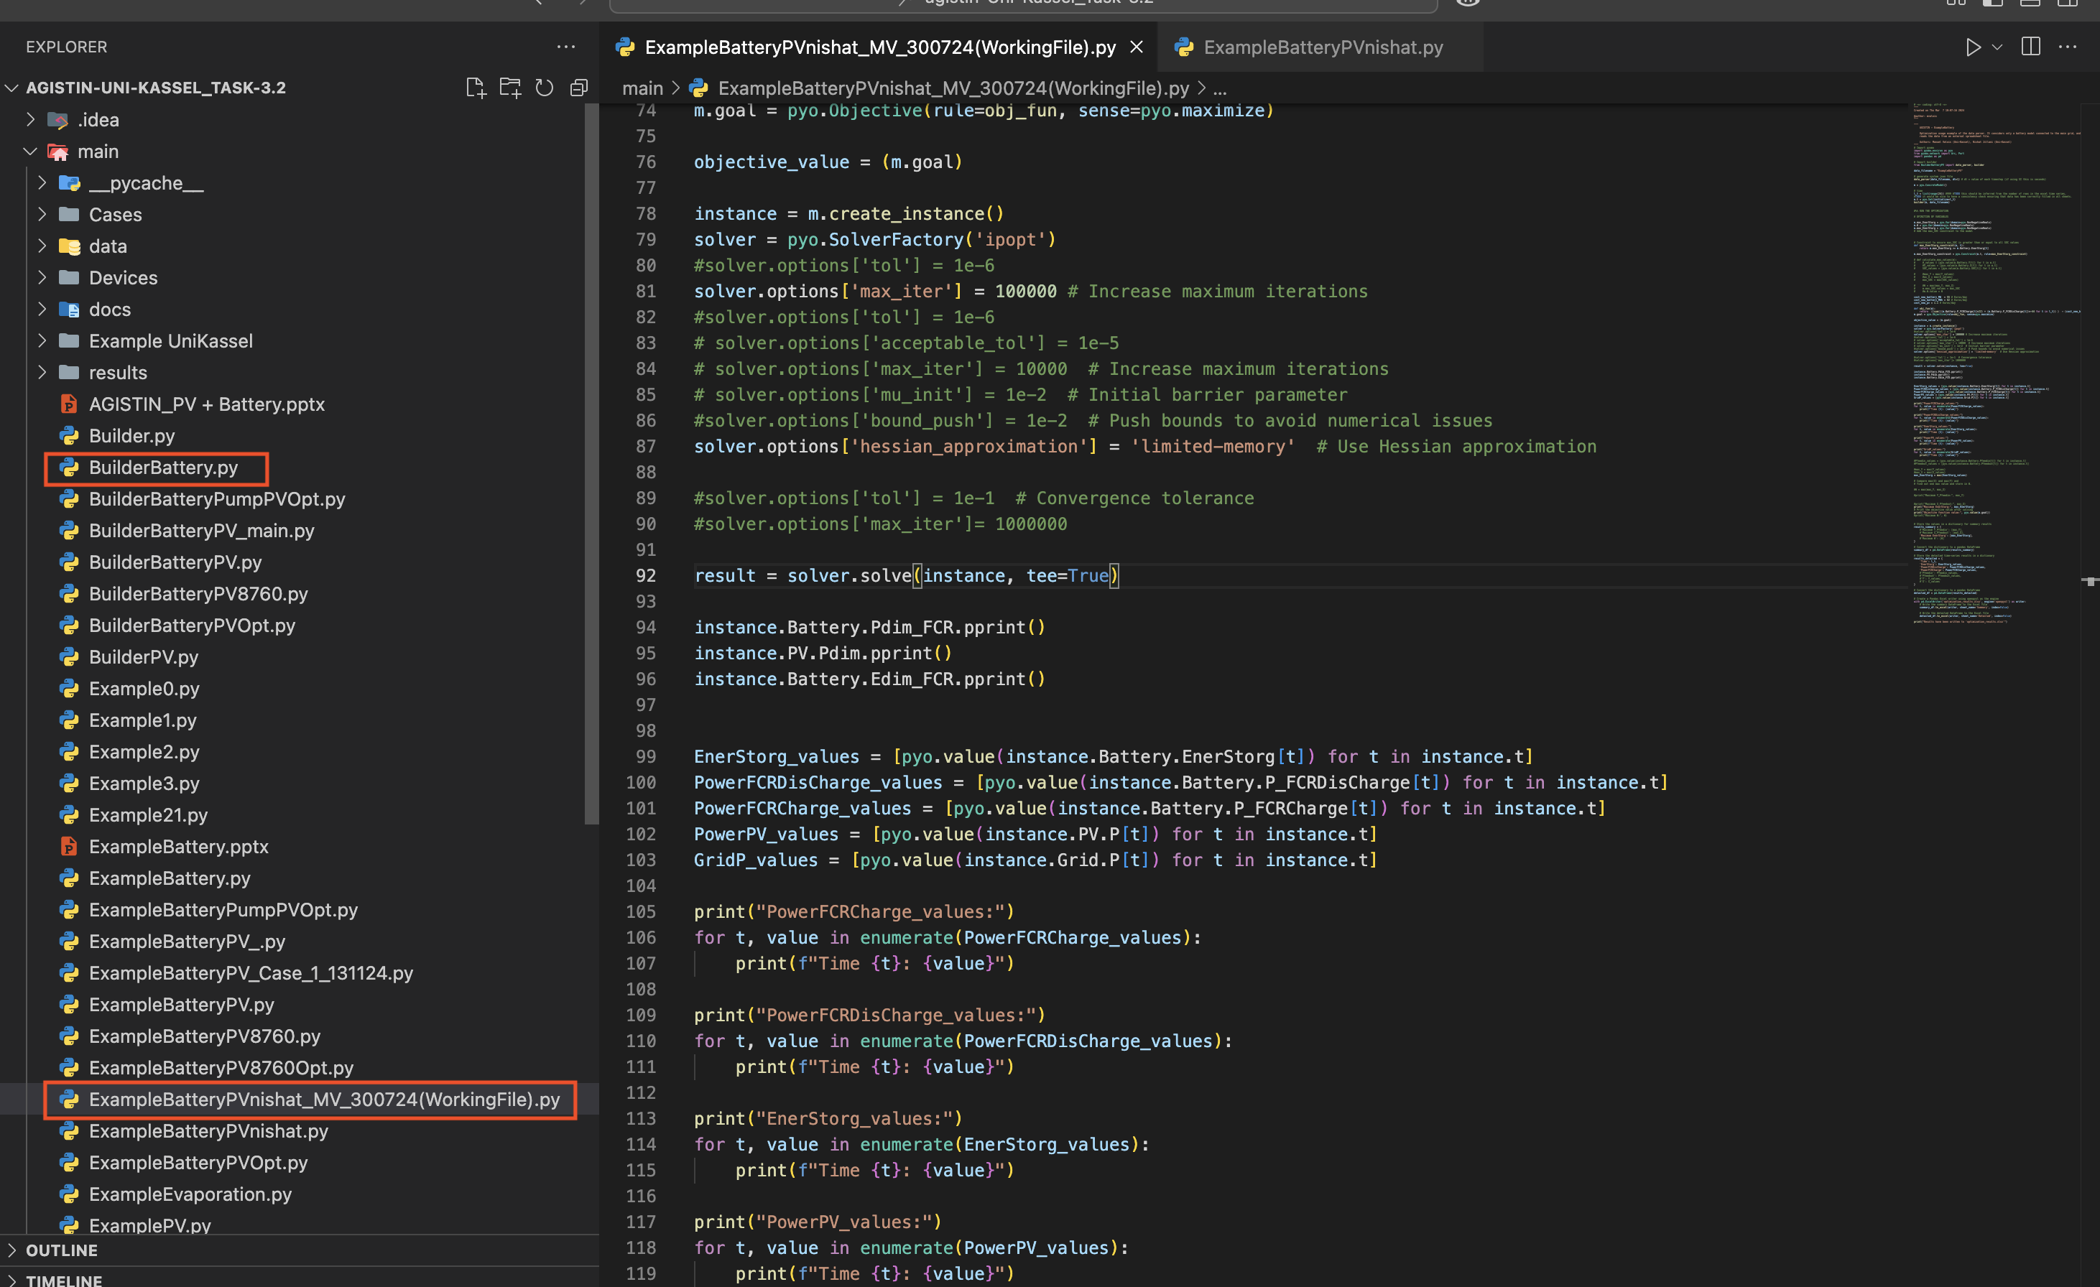
1- In this, we have a main file: ExampleBatteryPVnishat_MV_300724(WorkingFile). 2- This file is where we declare the data points, and we can custom-select the ones present in the Excel file. 3- There's also a builderbattery.py file, which helps in calling our JSON and Excel files. We don't make many changes to this file.

Slide 8
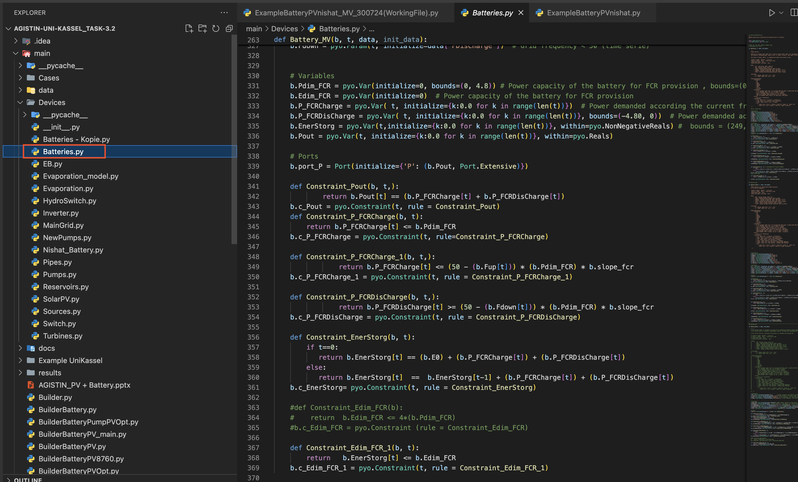
1- In this, we have a devices folder containing the batteries.py file. 2- In this file, we declare different variables, constraints, and functions that we want to print or use.

Slide 9
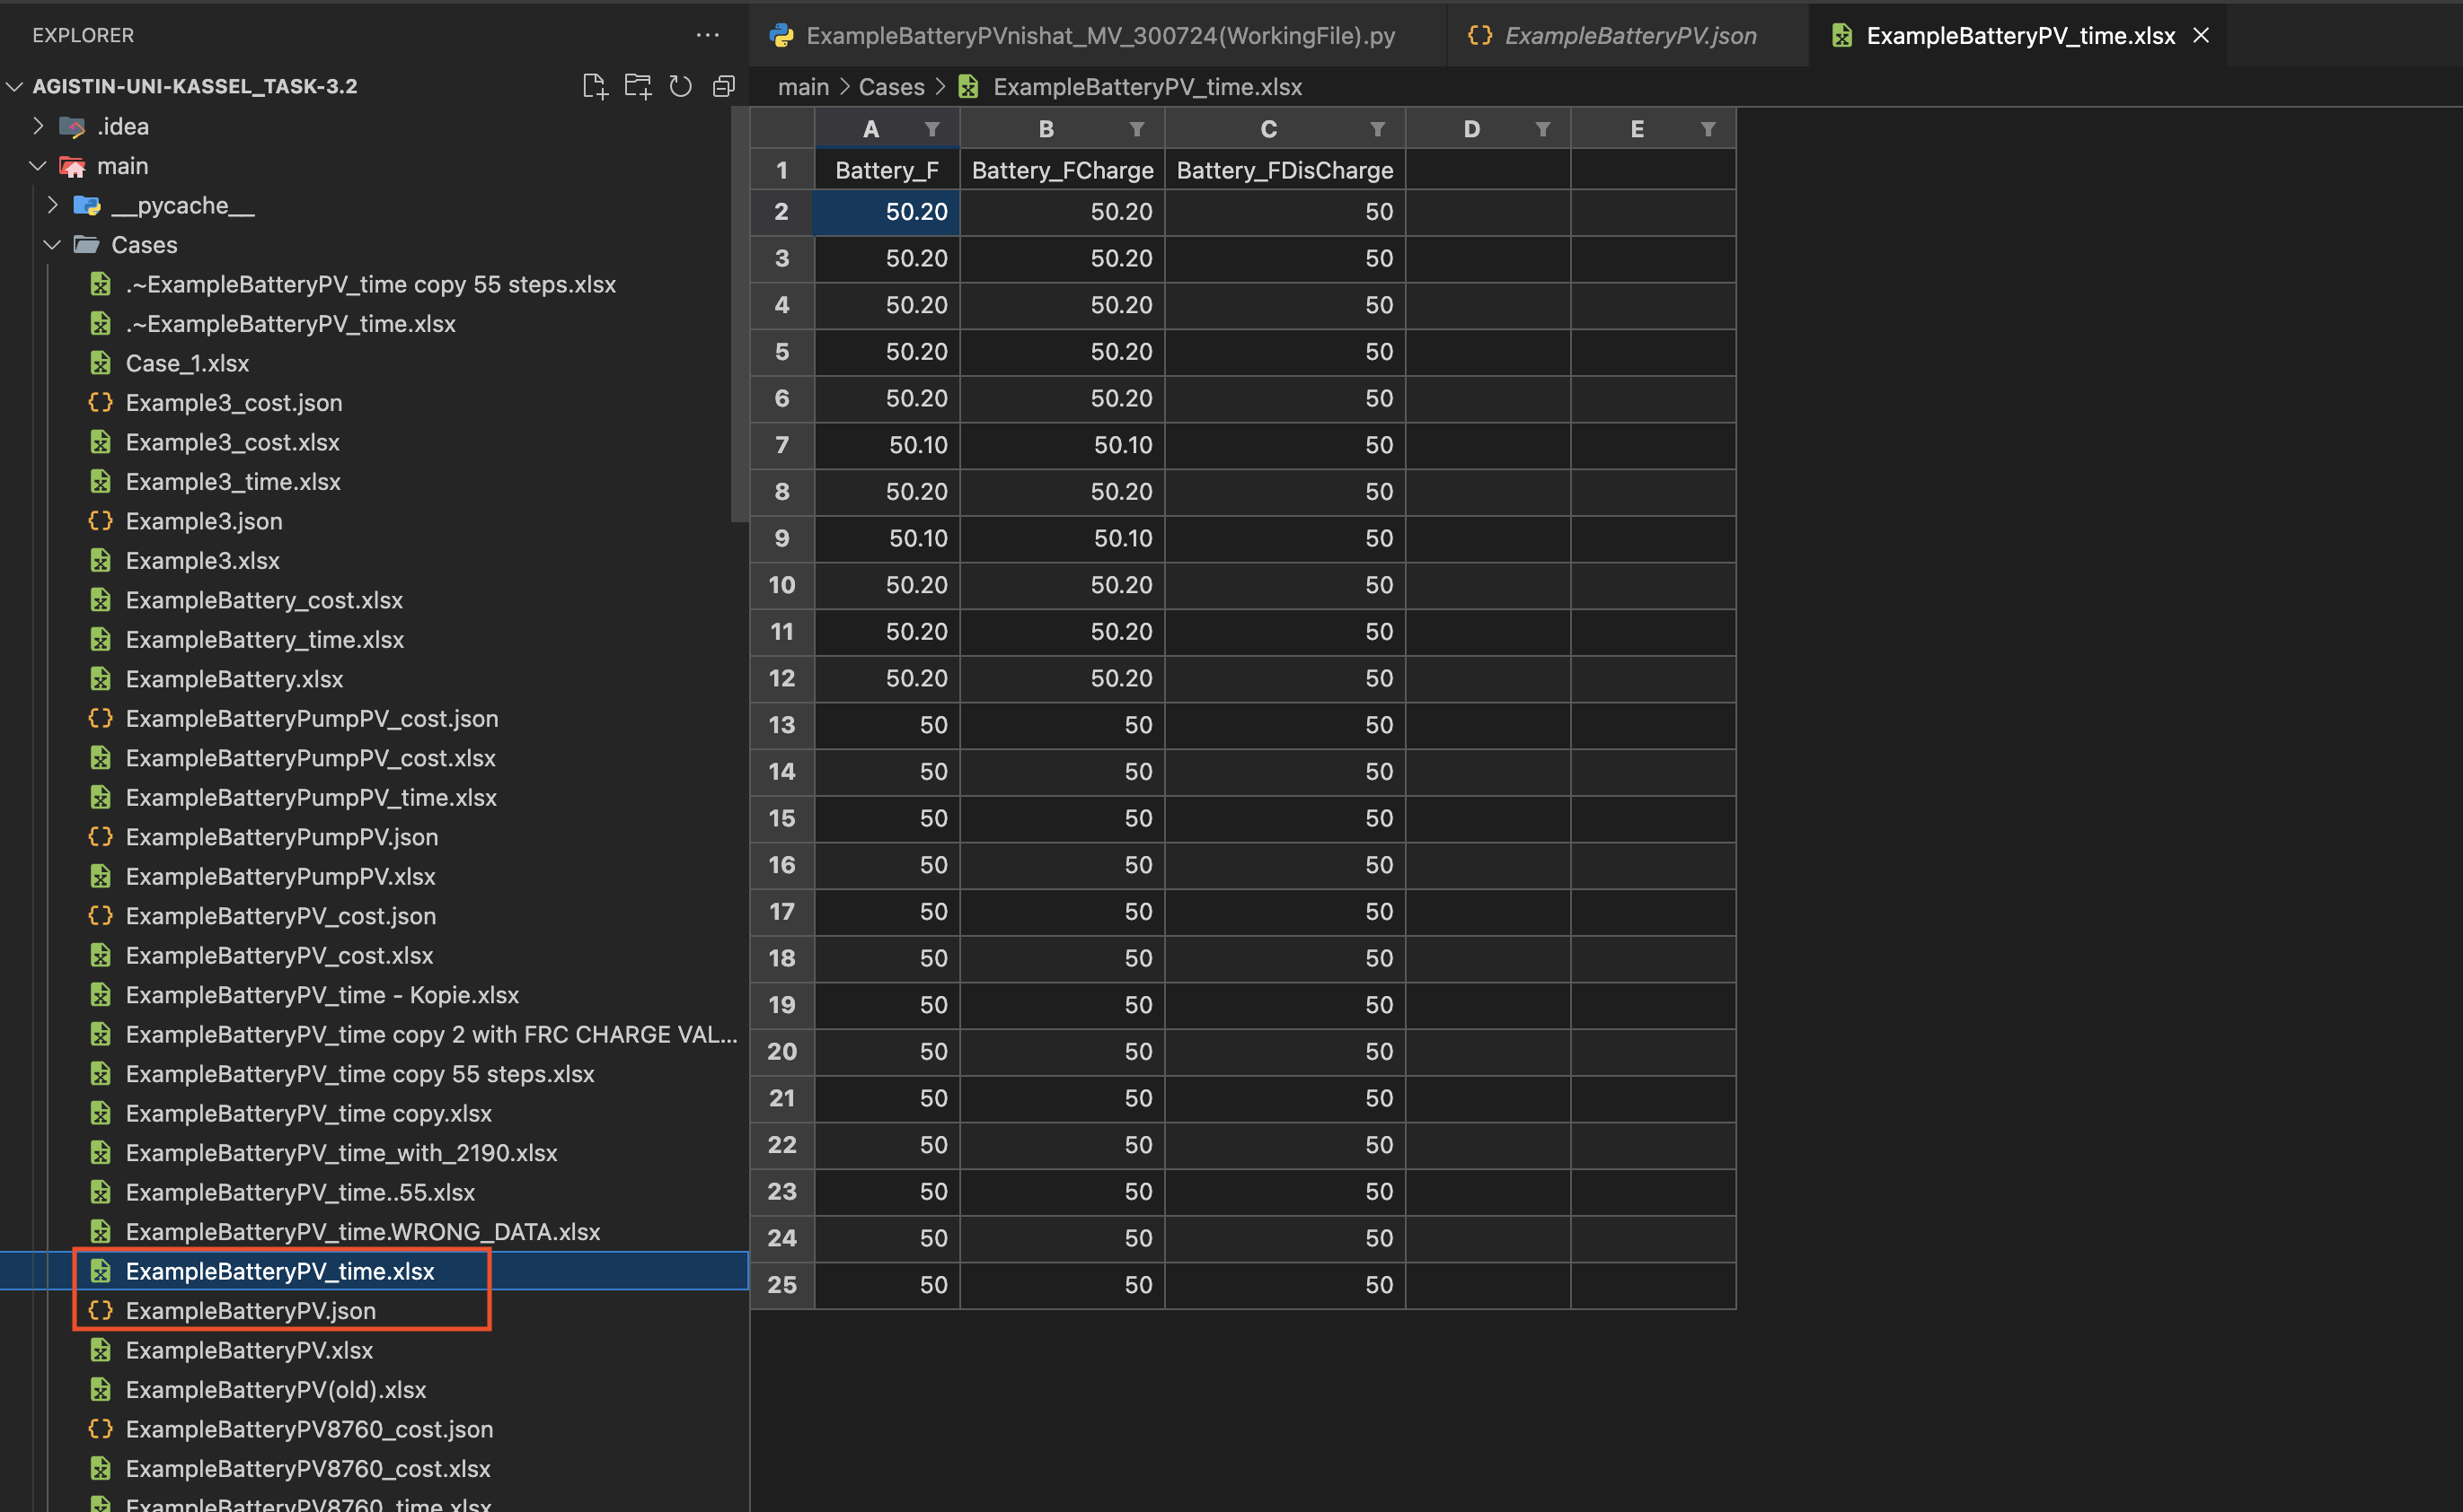
1- In this, we have a cases folder that contains 3 files, which are marked. 2- The important file is examplebatteryPV_time, where we declare our data points. 3- To run different cases, these 3 files are used.

Slide 10
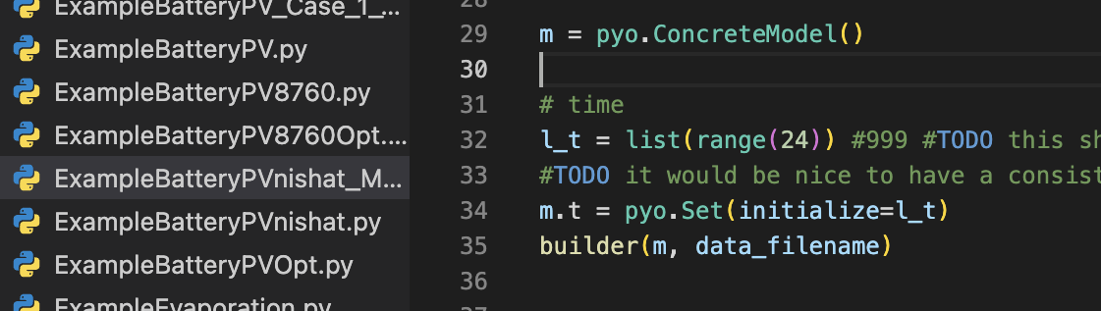
Key Battery Model Files
Core Model File: 'BuilderBatteryPV' is crucial for assembling and developing the comprehensive battery model architecture efficiently.
Test Case Definition: 'ExampleBatteryPVnishat_MV_300724' outlines specific test conditions to ensure model robustness and reliability.
File Integration: Integration of these files enhances project modularity, facilitating easier adjustments and future developments.

Slide 11
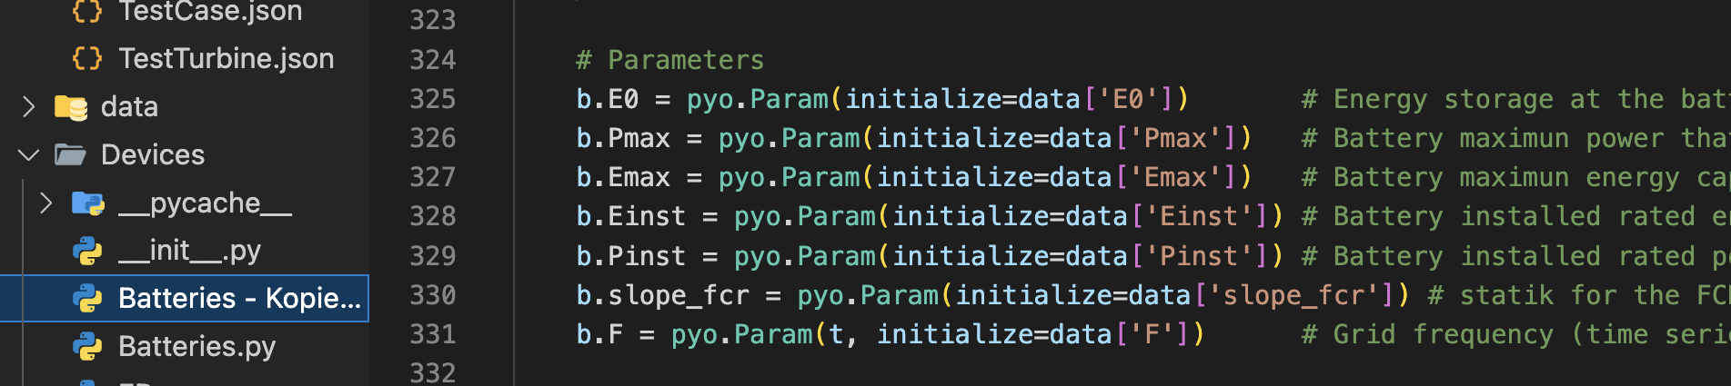
Batteries.py - Parameters
Initial Energy Storage: Parameter b.E0 indicates the initial stored energy within the battery, facilitating mathematical optimization.
FCR Performance Slope: The variable b.slope_fcr represents the effective change in frequency response during charging and discharging phases.
Grid Frequency Deviations: Parameters b.Fup and b.Fdown define acceptable grid frequency thresholds for efficient battery operation management.

Slide 12
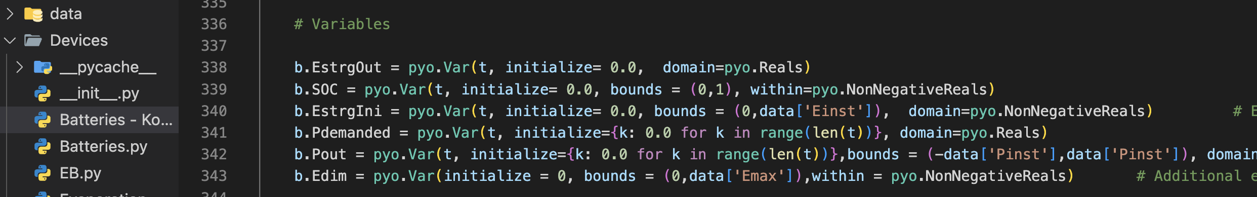
Batteries.py - Variables
Max Power Capacity: Variable b.Pdim_FCR defines the battery's maximum power output during operational scenarios and peak demands.
Energy Capacity: The energy storage capacity, represented by b.Edim_FCR, determines total energy storage available for discharge cycles.
Net Battery Output: b.Pout indicates the actual output power from the battery, factoring in charging and discharging events.

Slide 13
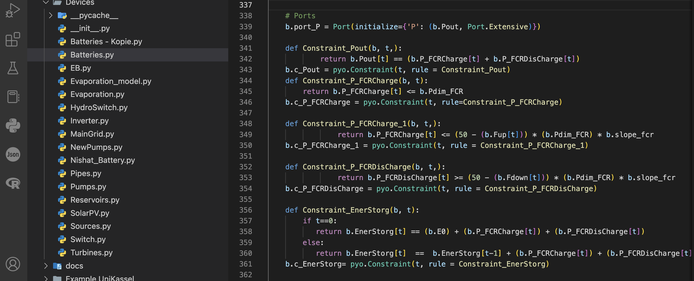
Batteries.py - Constraints
Power Output Constraint: Constraint_Pout ensures balance between charging and discharging power, maintaining operational stability and efficiency.
State of Charge Tracking: Constraint_EnerStorg monitors the State of Charge, aligning with initial energy levels for optimal performance.
Energy Capacity Limits: Constraint_Edim_FCR_1 defines the maximum and minimum energy capacities, ensuring the battery operates within safe thresholds.

Slide 14
ExampleBatteryPV_Case_1_131124.py
Cost Parameters: Fixed daily costs for capacities are crucial to evaluate financial feasibility of the battery system.
Time Steps: We can customize them in the Excel file, for example, in ExampleBatteryPV_time, and then declare them in the main file: ExampleBatteryPVnishat_MV_300724(WorkingFile).
Decision Variables: Key decision variables Power and Energy Capacity of the battery for optimization.

Slide 15
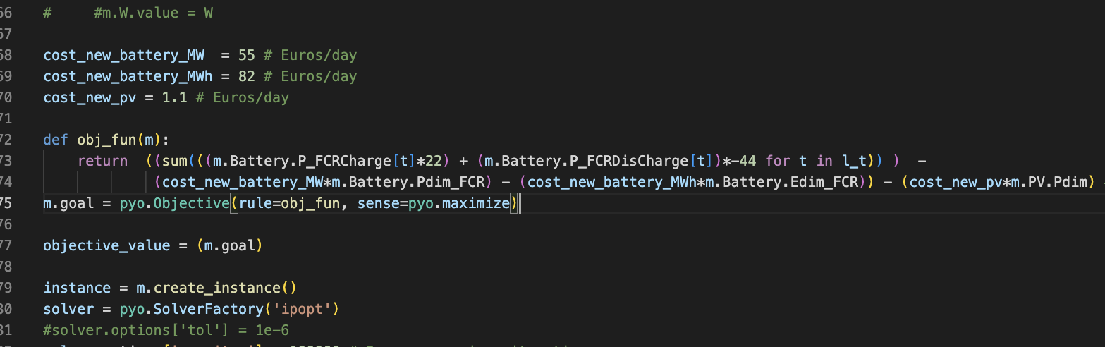
Optimization Workflow
Input Data Parsing: This initial phase involves organizing and cleansing datasets for accurate model input during optimization.
Model Building with Pyomo: Utilizing Pyomo, models integrate various components, defining relationships crucial for effective energy management solutions.
Results Extraction and Analysis: Post-optimization analysis evaluates outputs, assessing model performance against predefined benchmarks for continuous improvement.

Slide 16

Data Handling & Solver
Data Handling Sources: The project utilizes external JSON files for structured data input, enhancing accessibility and integration.
Solver Configuration: Ipopt settings include customized max iterations.
Execution of optimization: Execute the constraints and the main file.

Slide 17
Conclusion
Integrated Model Overview: The comprehensive framework combines battery storage, PV systems, and grid interaction for optimized energy management.
Benefits of Integration: Enhanced efficiency, cost reduction, and improved reliability are key benefits observed from the integrated model implementation.
Next Steps: Focus on further testing and optimization will ensure sustained improvements in model performance and scalability.

Slide 18


